Slide 1

CAPSTONE PROJECT: BATTLE OF THE NEIGHBORHOODS Assessment of the Relocation Options
Alexander zhilinsky
Calgary, April 2020

Slide 2
Introduction
Identify best community in Kitchener and Waterloo by analyzing data from the following sources:
Canada Mortgage and Housing Corporation (CMHC)
Kitchener GeoHub
Foursquare City Guide
Wikipedia.

Slide 3
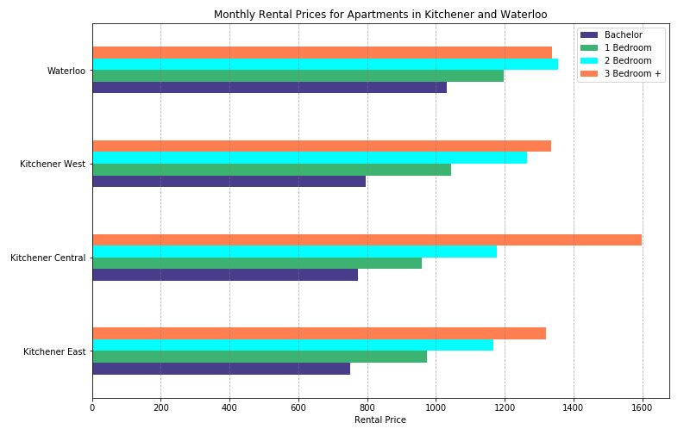
Canada Mortgage and Housing Corporation (CMHC)

Slide 4
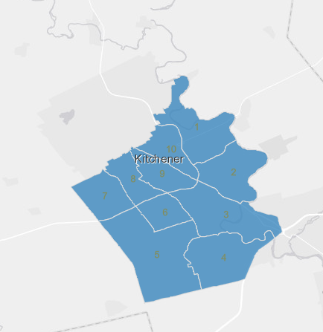
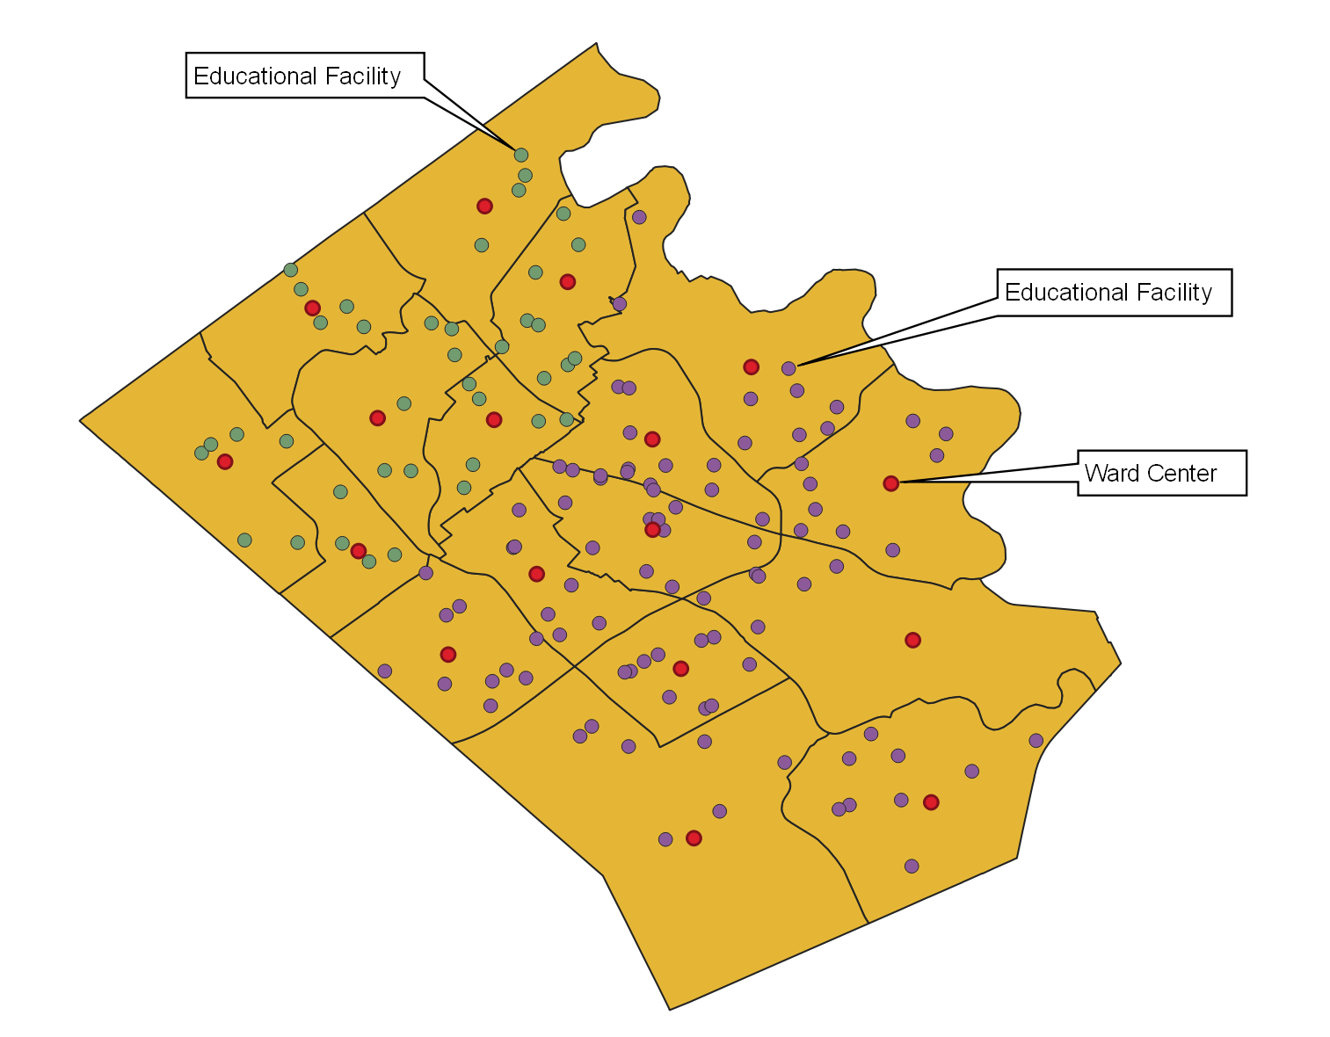
Kitchener GeoHub
Shape files with boundaries and addresses for Waterloo and Kitchener Wards

Slide 5
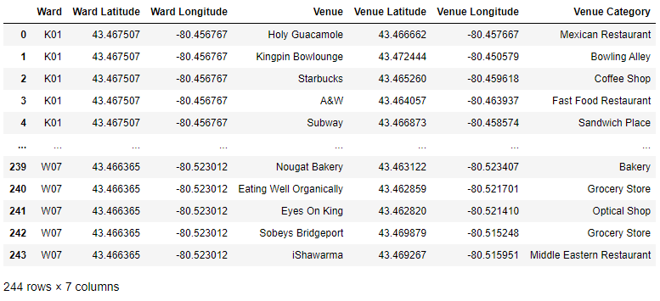
Foursquare City Guide
Retrieved information about venues

Slide 6
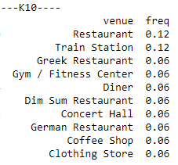
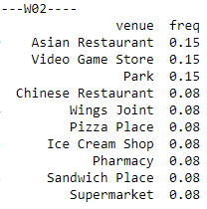
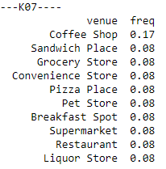
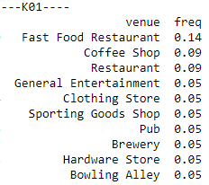
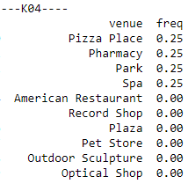
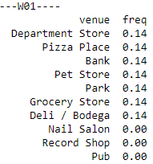
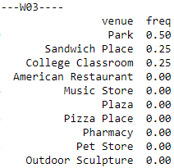
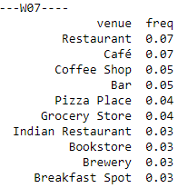
Foursquare City Guide (continued)
Example: Top 10 venues per Ward

Slide 7
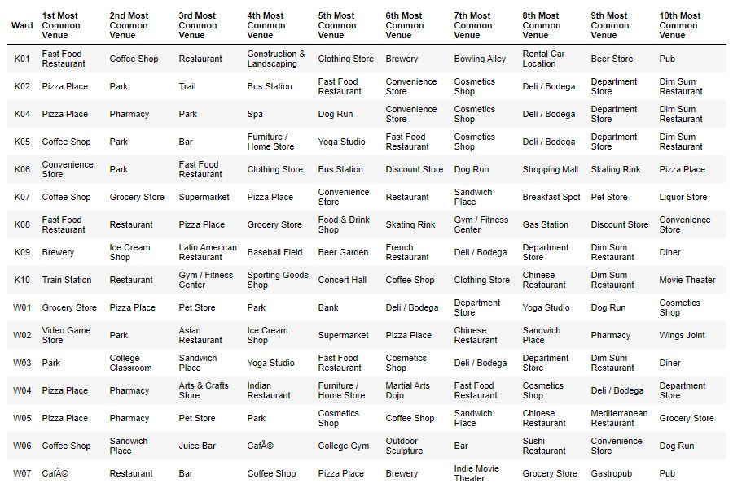
Top 10 Venues Per Ward

Slide 8
Clustering Results

Slide 9
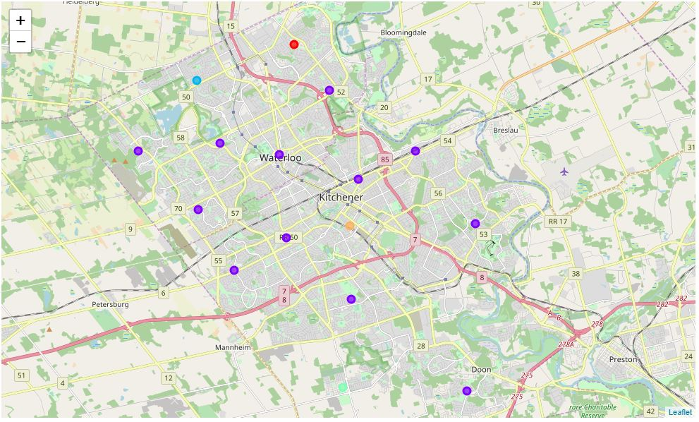
Cluster Map
Cluster 0
Cluster 2
Cluster 4
Cluster 1
Cluster 1

Slide 10
Conclusion
Available open data provided sufficient input for analysis and decision making
Cluster 1 includes most suitable communities for a families
Additional layers of information can be added to this project to analyze potential job opportunities, education, etc.

